Slide 1

This
Understanding the "this" keyword in JavaScript
SoftUni Team
Technical Trainers
Software University
http://softuni.bg

Slide 2
Table of Content
What Is "This"?
Usages Of "This" Keyword
In Objects
In Browser
In Events
"This" In Functions
Explicit Binding

Slide 3
Have a Question?
sli.do
#js-advanced

Slide 4
this
Introduction to "this"

Slide 5
Interpreter and Execution Context
Interpreter reads and executes code line by line
Execution Context
The scope in which the line is being executed
The JavaScript runtime maintains a stack of these execution contexts
The execution context present at the top of this stack is currently being executed

Slide 6
this
Special keyword in JavaScript
Unlike C#, Java, PHP, etc. in JS this is not always an instance of the current object of some class
Its value is based on the context
There are differences in strict mode
The object that this refers to changes every time execution context is changed

Slide 7
What is Function Context?
The function context is the object that owns the currently executed code
Function context === this object
Depends on how the function is invoked
Function invocation: func()
Method invocation: object.function()
Constructor invocation: new Array()
Event handler: domElement.event()
Indirect invocation: call() / apply() / bind()

Slide 8

"This" in Different Context

Slide 9
"This" with Function invocation
This is the global object in a function invocation
console.log(this === global); // false
function solve() {
return this;
}
console.log(solve() === global) // true

Slide 10
Function invocation in Strict Mode
Strict Mode
No Strict Mode
function solve() {
"use strict";
console.log(this);
}
solve(); // undefined
function solve() {
console.log(this);
} solve();
// Object [global]

Slide 11

"This" Keyword in the Browser
let b = "b";
console.log(this.b); //undefined
var a = "a";
console.log(this.a); //a
function foo() {
console.log("Simple function call");
console.log(this === window); // true
} foo();

Slide 12
"This" in a Method invocation
This is the object that owns the method
let person = {
firstName: "Peter",
lastName: "Ivanov",
fullName: function(){
return this.firstName + " " + this.lastName
},
whatIsThis: function(){ return this }
} console.log(person.fullName()); // Peter Ivanov
console.log(person.whatIsThis()); // person

Slide 13
"This" Refers to the Parent Object
function foo() {
console.log(this === global);
}
let user = {
count: 10,
foo: foo,
bar: function () { console.log(this === global); }
}
user.foo() // false
let func = user.bar;
func() // true
user.bar() // false

Slide 14
"This" with Inner Functions
this variable is accessible only by the function itself
function outer() {
console.log(this); // Object {name: "Peter"}
function inner() {
console.log(this); // Window
}
inner();
}
const obj = { name: 'Peter', func: outer }
obj.func();

Slide 15
"This" with Arrow Functions
this retains the value of the enclosing lexical context
function outer() {
const inner = () => console.log(this);
inner();
}
const obj = {
name: 'Peter',
func: outer
};
obj.func(); // Object {name: "Peter"}

Slide 16
"This" in Constructor invocation
The value of this refers to the newly created instance
function Person(fn, ln) {
this.first_name = fn;
this.last_name = ln;
}
Person.prototype.displayName = function () {
console.log(`Name: ${this.first_name} ${this.last_name}`);
};
let person = new Person("John", "Doe");
person.displayName(); // John Doe

Slide 17
"This" in Constructor invocation
The value of this refers to the newly created instance
class Person {
constructor(fn, ln) {
this.first_name = fn;
this.last_name = ln;
this.displayName = function () {
console.log(`Name: ${this.first_name} ${this.last_name}`);
} } };
let person = new Person("John", "Doe");
person.displayName(); // John Doe

Slide 18
In Events
In event handlers, this is set to the element the event fired from
element.addEventListener("click", function(e) {
console.log(this === e.currentTarget); // Always true
});

Slide 19
f(x)
"This" in Functions

Slide 20
this
this
this
this
this
this
this
this
this
this
Explicit Function Binding
call, apply, bind

Slide 21
Explicit Binding
Occurs when call(), apply(), or bind() are used on a function
Forces a function call to use a particular object for this binding
function greet() {
console.log(this.name);
}
let person = { name:'Alex' };
greet.call(person, arg1, arg2, arg3, ...); // Alex

Slide 22
Changing the Context: Call
Calls a function with a given this value and arguments provided individually
const sharePersonalInfo = function (...activities) {
let info = `Hello, my name is ${this.name} and`+ + `I'm a ${this.profession}.\n`;
info += activities.reduce((acc, curr) => {
let el = `--- ${curr}\n`;
return acc + el;
}, "My hobbies are:\n").trim(); return info;
} // Continues on the next slide…

Slide 23
Changing the Context: Call
const firstPerson = { name: "Peter", profession: "Fisherman" };
console.log(sharePersonalInfo.call(firstPerson, 'biking', 'swimming','football'));
// Hello, my name is Peter.
// I'm a Fisherman.
// My hobbies are:
// --- biking
// --- swimming
// --- football

Slide 24
Changing the Context: Apply
Calls a function with a given this value, and arguments provided as an array
apply() accepts a single array of arguments, while call() accepts an argument list
If the first argument is undefined or null a similar outcome can be achieved using the array spread syntax

Slide 25
Apply() - Example
const firstPerson = {
name: "Peter",
prof: "Fisherman",
shareInfo: function () {
console.log(`${this.name} works as a ${this.prof}`);
}
};
const secondPerson = { name: "George", prof: "Manager" };
firstPerson.shareInfo.apply(secondPerson);
// George works as a Manager

Slide 26
Changing the Context: Bind
The bind() method creates a new function
Has its this keyword set to the provided value, with a given sequence of arguments preceding any provided when the new function is called
Calling the bound function generally results in the execution of its wrapped function
Bind makes a permanent context link and will always keep it
Bound function cannot change it’s linked context when using call or apply with a different context or even a rebound doesn’t have any effect

Slide 27
Bind - Example
const x = 42;
const getX = function () {
return this.x;
}
const module = {x , getX };
const unboundGetX = module.getX;
console.log(unboundGetX()); // undefined
const boundGetX = unboundGetX.bind(module);
console.log(boundGetX()); // 42

Slide 28
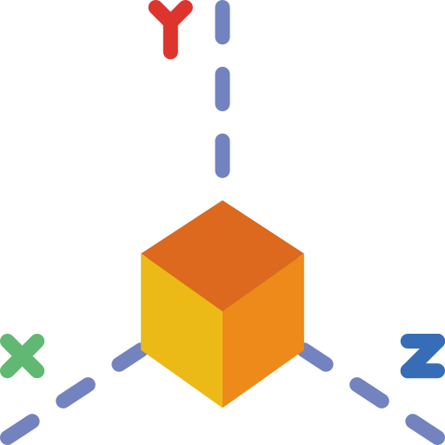
Problem: Area and Volume Calculator
The functions area and vol are passed as parameters to your function
function area() {
return this.x * this.y;
};
function vol() {
return this.x * this.y * this.z;
};

Slide 29
Problem: Area and Volume Calculator
Calculate the area and the volume of figures, which are defined by their coordinates (x, y and z), using the provided functions
'[
{"x":"1","y":"2","z":"10"},
{"x":"7","y":"7","z":"10"},
{"x":"5","y":"2","z":"10"}
]'
[
{ area: 2, volume: 20 },
{ area: 49, volume: 490 },
{ area: 10, volume: 100 }
]

Slide 30
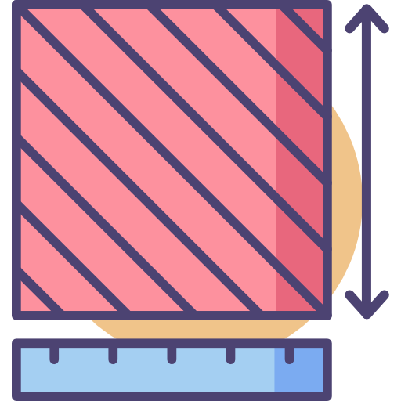
Solution: Area and Volume Calculator
function solve(area, vol, input) {
let objects = JSON.parse(input);
function calc(obj) {
let areaObj = Math.abs(area.call(obj));
let volumeObj = Math.abs(vol.call(obj));
return { area: areaObj, volume: volumeObj }
}
return objects.map(calc);
}

Slide 31
Problem: Person
Return an object with firstName, lastName and fullName
If firstName or lastName are changed, then fullName should also be changed
If fullName is changed, then firstName and lastName should also be changed
let person = new Person("Albert", "Simpson");
console.log(person.fullName);//Albert Simpson
person.firstName = "Simon";
console.log(person.fullName);//Simon Simpson

Slide 32

Solution: Person
function Person(first, last) {
this.firstName = first;
this.lastName = last;
Object.defineProperty(this, "fullName", {
set: function(value) {
// ToDo
},
get: function() {
// ToDo
}
}
);
}

Slide 33

Practice
Live Exercise in Class (Lab)

Slide 34

Summary
Functional Context
What this refers to depends on where and how the function that is being executed is called
bind, apply and call are all functions that can be used to explicitly set the value of this
…
…
…

Slide 35
https://softuni.bg/courses/js-applications

Slide 36












SoftUni Diamond Partners

Slide 37




SoftUni Organizational Partners

Slide 38




Trainings @ Software University (SoftUni)
Software University - High-Quality Education and Employment Opportunities
softuni.bg
Software University Foundation
http://softuni.foundation/
Software University @ Facebook
facebook.com/SoftwareUniversity
Software University Forums
forum.softuni.bg

Slide 39

License
This course (slides, examples, demos, videos, homework, etc.) is licensed under the "Creative Commons Attribution-NonCommercial-ShareAlike 4.0 International" license

